Slide 1
Software Testing
Specification-Based, Unit, Equivalence Class Testing
Presented By
Ning Chen, Ph.D.
Professor
Department of Computer
Science
California State University,
Fullerton
© Ning Chen, 2017
*

Slide 2
Module Objectives
This module focuses on the Specification-Based, Unit, Equivalence Class Testing

Slide 3
Why?
Why do we need another testing?
Is the boundary value testing good enough?
  The boundary value testing is not bad. It offers us a systematic way of coming up with limited number of test cases. Nevertheless, we only test one normal value and the rest are around the boundaries.
  Will we have failures that occur not around the boundaries (say, maybe in between the normal value and the boundary)? Hard to say! Yes, we have covered one normal value and areas around the boundaries. Have we covered other “areas”? Should we?

Slide 4
Idea
Supposed we have a way to divide the input domain into several areas (or, better yet, some problems have an input area consisting several areas naturally), should we place one (or more) test case(s) in each area?

Slide 5
Idea
Let’s see an example. Again, we assume that the input domain has two variables of x and y (so that it is easier to see graphically). X shows some kind of a natural separation of 1 to 10, 10 to 20, and 20 to 30 (3 separations). Y shows a separation of 1 to 5, 5 to 10, 5 to 15, and 15 to 20 (4 separations).

Slide 6
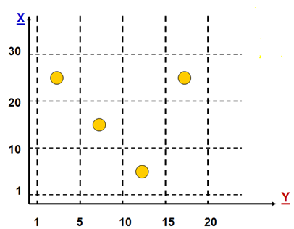
Example
If you plot the input domain, you will end up with a graph with 12 partitions as shown below:

Slide 7
Now it is time to pick test cases
At this point, you may say, let’s place one test case in each partition. We have 12 partitions, therefore, we should have 12 test cases (12 dots on the graph).
Wait a minute! Someone only places 4 dots (not 12) on the graph. Why?

Slide 8
Why?
Well, you have to realize that as a tester, we have conflicting goals.

Slide 9
Conflicting Goals
On one hand, we want to test all partitions to achieve a sense of “completeness.” On the other hand, we also want to reduce the cost of testing (that means to use as few test cases as possible).
If we can get away with fewer than 12 test cases, we should try.

Slide 10
How?
For those of you who believe in single fault assumption, it turns out, four test cases are sufficient (instead of 12).

Slide 11
Single Fault Assumption
What do you mean “single fault assumption” anyway?
This assumption states that most likely, a fault, when it occurs, can be traced back to things associated to a single input variable.

Slide 12
Explanation
For example, in our case, the input domain has two variables (x and y). When a fault occurs, we may say, well, this fault can be traced back to things (code, structure, whatever) related to the variable y, but not x. Now we want to do test to expose this fault. What should we do? Notice that the variable y has four partitions. Obviously, we want to have at least one test case in each of the y partition. If you check the partition line along the Y variable, indeed, the above given graph shows four dots.

Slide 13
How About X?
How about if we want to test a fault that is associated with the x variable? Do we have at least one test case in each partition of the x variable? Indeed, if you inspect the graph along the x variable, in each of its partition, you can find at least one dot.

Slide 14
What is the Name?
We need to come up with a name that describes what we have done here. The literature calls it Weak Normal Equivalence Class Testing. If we have a chance to name this approach ourselves (which we don’t), we really prefer to call it Single-Fault Normal Equivalence Class Testing to remind ourselves that the single-fault assumption is the real “beef” here.

Slide 15
I don’t Buy It
What if you don’t buy the single fault assumption and believe that a fault may be associated with things that are a function of multiple variables?

Slide 16
I don’t Buy It
Well, easy, you simply place at least one test case in each possible partition combinations as shown below:

Slide 17
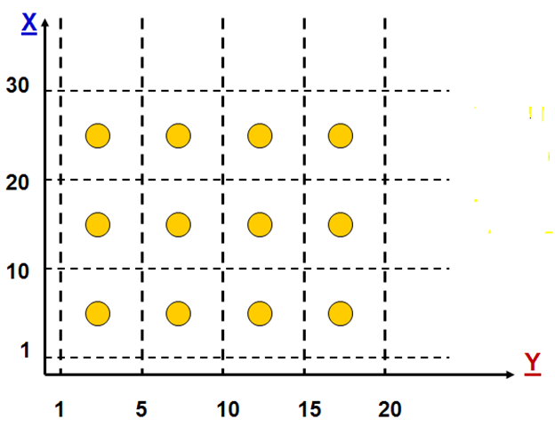
I don’t Buy It

Slide 18
Name?
In literature this way of selecting test cases is called Strong Normal Equivalence Testing. Is this the best possible name. We don’t thinks so. If we have our way (which we don’t), we really prefer to call it Multiple Fault Normal Equivalence Testing.

Slide 19
Other worries?
Do we need to worry about areas outside the boundary of our partitions?

Slide 20
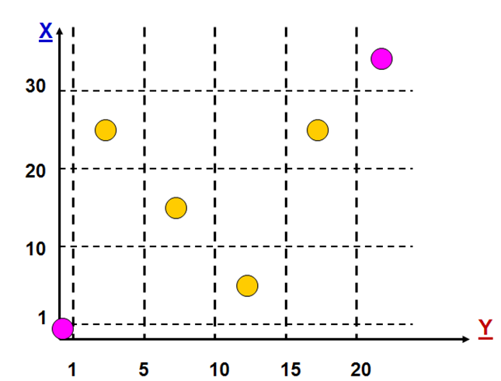
If We Do

Slide 21
Name?
This approach is called Weak Robust Equivalence Testing. Again, if we have our way, we prefer to call it Single Fault Robust Equivalence Testing.

Slide 22
Multiple Fault Case
If we accept the multiple fault assumption, we will end up with:

Slide 23
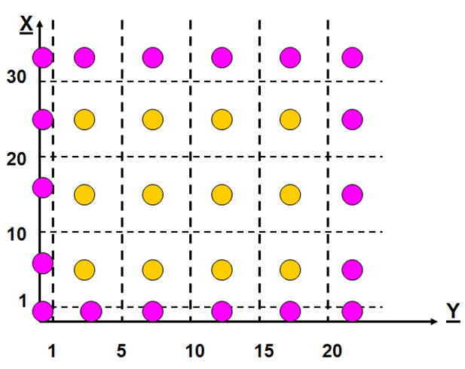
Multiple Fault Case

Slide 24
Name?
This approach, not surprising, is called Strong Robust Equivalence Class Testing. If we have our way, we prefer to call it Multiple Fault Robust Equivalence Class Testing.

